Slide 1
K-Nearest Neighbours
CS 512:
Project Group 52
Manasvini Nittala (mn777), Sahithi Reddy Sakinala(ss4362), Jahnavi Manchala (jm2658)

Slide 2
INDEX
1 | Different names of KNN
2 | Introduction - What is KNN?
3 | Overview of KNN
4 | KNN Modeling and Classification Algorithm
5 | Applications of KNN in Machine Learning
6 | Distance measure for Continuous Variables
7 | Advantages of KNN
8 | Disadvantages of KNN

Slide 3
Different names of KNN
K-Nearest Neighbors
Memory-Based Reasoning
Example-Based Reasoning
Instance-Based Learning
Lazy Learning

Slide 4
Introduction - What is KNN?
K-Nearest Neighbors Algorithm is one of the simple, easy-to-implement, and yet effective supervised machine learning algorithms. We can use it in any classification (This or That) or regression (How much of This or That) scenario. It predicts responses for new data (testing data) based upon its similarity with other known data (training) samples. It assumes that data with similar traits sit together.
It is called a lazy learner algorithm because it does not learn from the training set immediately instead it stores the dataset and at the time of classification, it performs an action on the dataset.

Slide 5
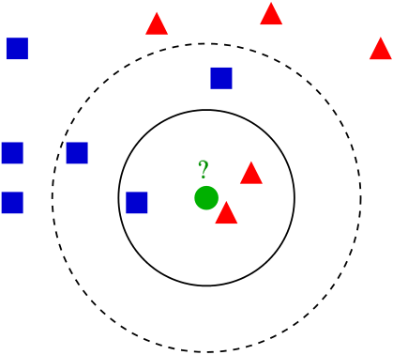
Overview of KNN

Slide 6
Let's look at a dataset in two dimensions. Consider a graph with a bunch of data points spread out in small clusters.
KNN examines the distribution of data points and divides them into groups based on the arguments provided to the model. The labels are then assigned to these groups.
The primary assumption of a KNN model is that data points/instances that are close to each other are highly similar, whereas data points that are far away from another group are dissimilar to those data points.
The distance between two points on a graph is used by a KNN model to calculate similarity. The farther apart the points are, the less similar they are. There are several methods for calculating distance between points, but the most commonly used distance metric is Euclidean distance (the distance between two points in a straight line)

Slide 7
KNN is a supervised learning algorithm, which means that the examples in the dataset must have labels assigned to them or be classified.
There are two other things you should know about KNN. First and foremost, KNN is a non-parametric algorithm. This means that when the model is used, no assumptions about the dataset are made.
Rather, the model is built entirely from the data provided. Second, when using KNN, the dataset is not divided into training and test sets. Because KNN makes no distinctions between a training and testing set, all of the training data is used when the model is asked to predict.

Slide 8
KNN Modeling and Classification Algorithm
Consider D to be a collection of n class-known data tuples d1, d2,..., dn. As an example, diD could be a document represented in the form of a space vector di=, where wij could be the normalised TF-IDF weighting representation in text categorization. To avoid limiting our algorithm to specific applications, we will use the term "data tuple" to represent all types of data in different applications. Also, the term "similarity measure" can refer to any similarity measure, such as Euclidean distance or Cosine similarity, as long as it is applicable to a specific application. For the sake of simplicity, we will now use Euclidean distance as the default similarity measure to describe the following algorithms. The following is a detailed description of the model construction algorithm.

Slide 9
(1) From the given training dataset, choose a similarity measure and generate a similarity matrix.
(2) Change the tag of all data tuples to 'ungrouped'.
(3) For each 'ungrouped' data tuple, find the largest local neighbourhood that includes the greatest number of neighbors in the same category.
(4) Among all the local neighbourhoods, find the data tuple di with the largest global neighbourhood Ni, create a representative Cls(di), Sim(di), Num(di), Rep(di)> into M to represent all the data tuples covered by Ni, and then set the tag of all the data tuples covered by Ni to 'grouped'.

Slide 10
(5) Repeat steps 3 and 4 until all of the data tuples in the training dataset are grouped.
(6) Model M is made up of all the representatives gathered during the preceding learning process.
M in the preceding algorithm represents the created model. Cls(di), Sim(di), Num(di), Rep(di)> represent the class label of di, the lowest similarity to di among the data tuples covered by Ni, the number of data tuples covered by Ni, and a representation of di itself, respectively. In step (4), if there are multiple neighborhoods with the same maximal number of neighbors, we select the one with the lowest Sim(di), i.e. the highest density, as representative. The following is a description of the classification algorithm:

Slide 11
(1) To classify a new data tuple dt, compute its similarity to all representatives in the model M.
(2) If dt is only covered by one representative, i.e. the Euclidean distance between dt and dj is less than Sim(dj), dt is classified as the category of dj.
(3) If dt is covered by at least two representatives of different categories, classify dt as the category of the representative with the largest Num(dj), i.e. the neighbourhood that covers the most data tuples in the training dataset.
(4) If no representative in the model M covers dt, classify dt as the category of a representative with the closest boundary to dt.

Slide 12
Pseudocode
Step 1: Determine parameter K= number of Nearest Neighbours.
Step 2: Calculate the distance between query-instance and all the training examples.
Step 3: Sort the distance and determine the nearest neighbours based on k-th minimum distance.
Step 4: Gather the category Y of the nearest neighbors.
Step 5: Use simple majority of the category of nearest neighbors as the prediction value of the query instance.

Slide 13
Applications of KNN in machine learning
The k-NN algorithm has been used in a variety of applications, most notably classification. Among these use cases are:
- Data preprocessing: Missing values are common in datasets, but the KNN algorithm can estimate them in a process known as missing data imputation.
- Recommendation Engines: The KNN algorithm has been used to provide automatic recommendations to users on additional content using clickstream data from websites. However, given KNN's scaling issues, this approach may not be suitable for larger datasets.

Slide 14
- Finance: It has also been used in a number of financial and economic applications.
- Healthcare: KNN has also been used in the healthcare industry to predict the risk of heart attacks and prostate cancer. The algorithm computes the most likely gene expressions.
- Pattern Recognition: KNN has also aided in pattern recognition, such as text and digit classification. This has been especially useful in identifying handwritten numbers on forms or mailing envelopes.

Slide 15
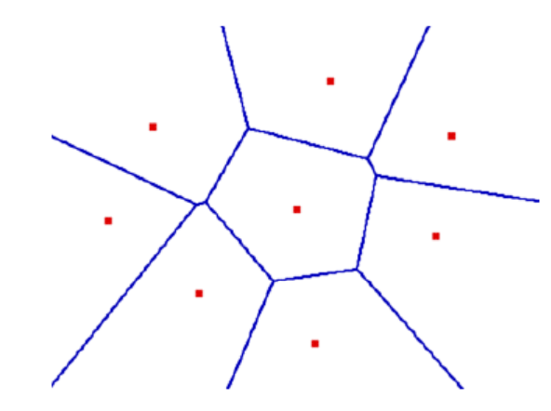
Decision Boundaries
Voronoi Diagram
Describes the areas that area nearest to any given point, given a set of data.
Each line segment is equidistant between two points of opposite class.

Slide 16
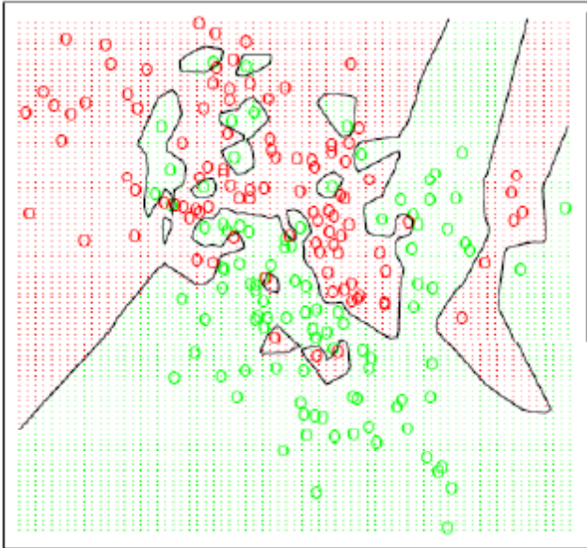
With large number of examples and possible noise in the labels, the decision boundary can become nasty !
“ Overfitting Problem”

Slide 17
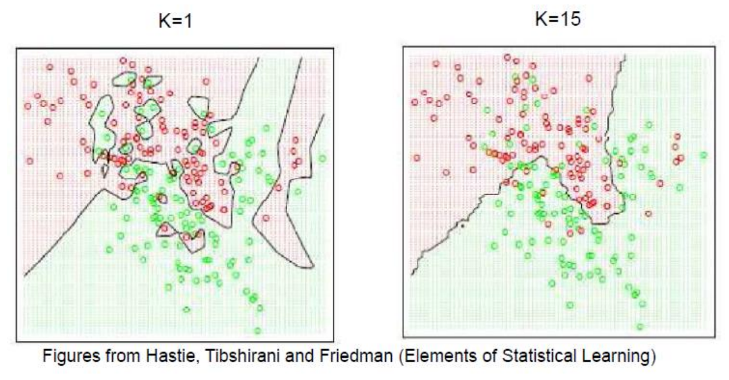
Effect of K
Larger k produces smoother boundary effect.
When K==N , always predict the majority class

Slide 18
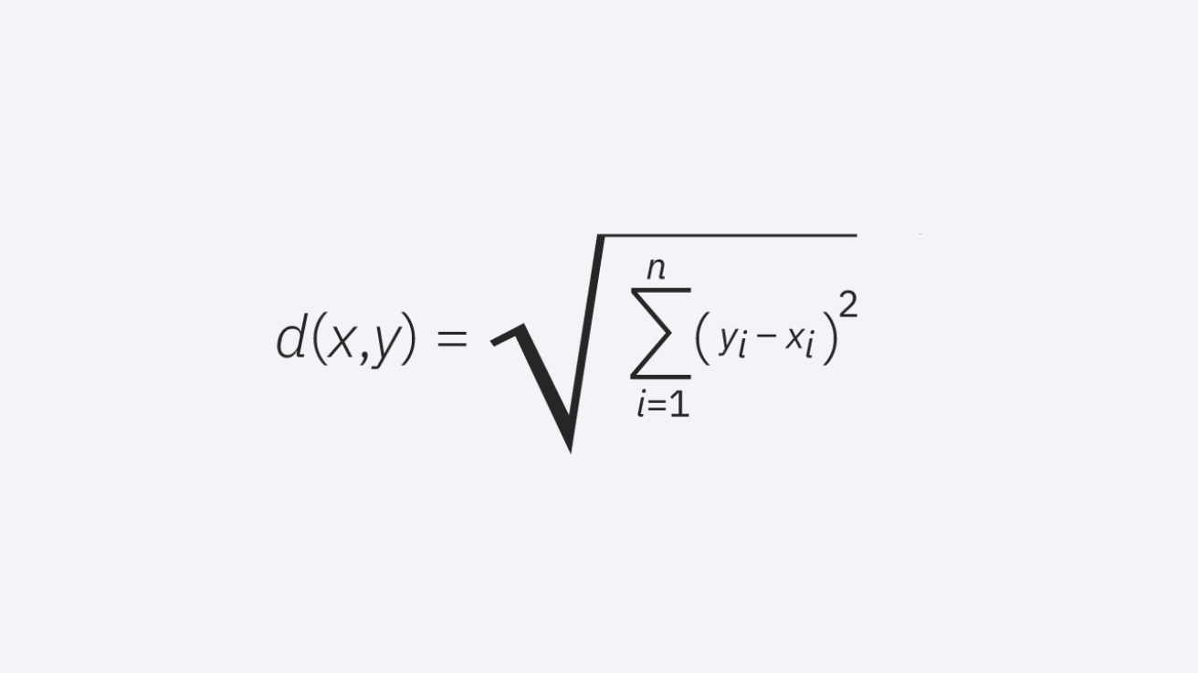
Distance measure for Continuous Variables
Euclidean Distance: The most commonly used distance measure is Euclidean distance (p=2), which is limited to real-valued vectors. It measures a straight line between the query point and the other point being measured using the formula below.

Slide 19
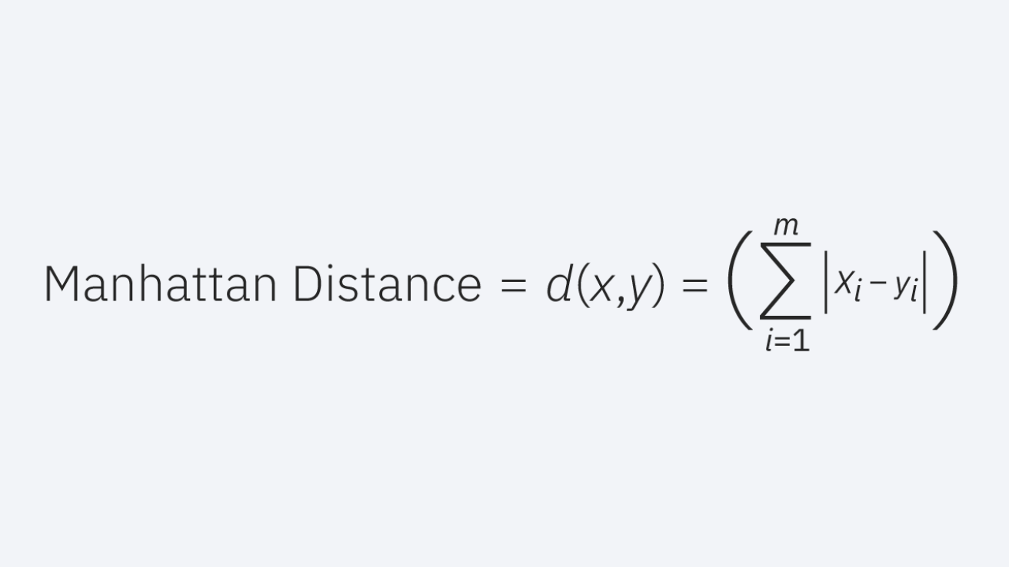
Manhattan distance: Another popular distance metric is the Manhattan distance (p=1), which measures the absolute value between two points. It is also known as taxicab distance or city block distance because it is commonly represented by a grid, illustrating how one might navigate from one address to another via city streets.

Slide 20
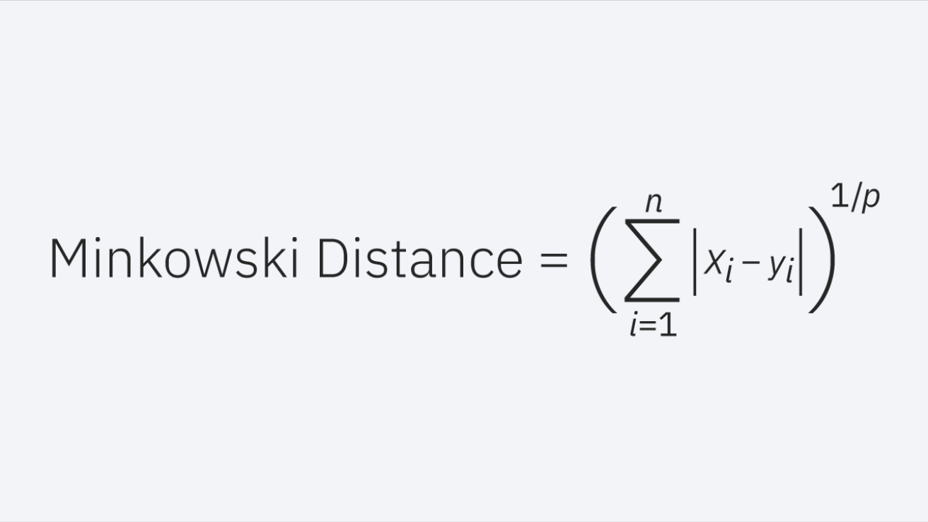
Minkowski distance: It is a generalized form of the Euclidean and Manhattan distance metrics. Other distance metrics can be calculated using the parameter p in the formula below. This formula represents Euclidean distance when p equals two, and Manhattan distance when p equals one.

Slide 21
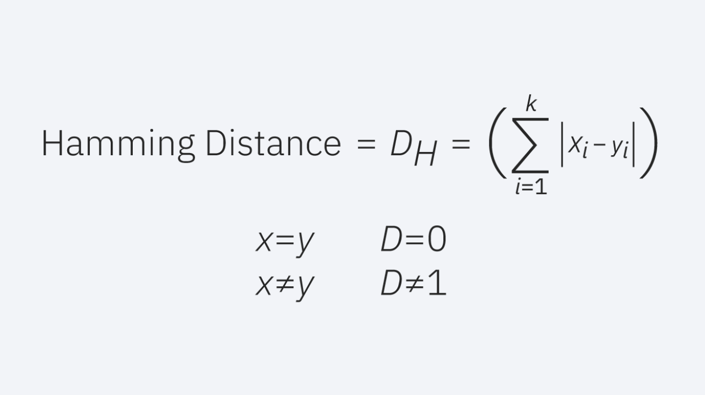
Hamming distance: This technique is commonly used with Boolean or string vectors to identify points where the vectors do not match. As a result, it is also known as the overlap metric. The following formula can be used to represent this:

Slide 22
Advantages of KNN
No Training Period- Because the data itself is a model that will be the reference for future prediction, KNN modeling does not include a training period. As a result, it is very time efficient in terms of improvising for a random modeling on the available data.
Simple Implementation- KNN is very simple to implement because the only thing that needs to be calculated is the distance between different points based on data from various features, and this distance can be easily calculated using distance formulas such as Euclidean or Manhattan.
Because there is no training period, new data can be added at any time without affecting the model.
The Vigenere square

Slide 23
Disadvantages of KNN
It does not work well with large datasets because calculating distances between each data instance would be prohibitively expensive.
Does not work well with high dimensionality because it complicates the process of calculating distance for each dimension.
Data that is sensitive to noise and missing data
Feature Scaling- Data in all dimensions should be properly scaled (normalized and standardized).

Slide 24
CONCLUSION
KNN: the lazy algorithm that won hearts
Despite being the laziest among algorithms, KNN has built an impressive reputation and is a go-to algorithm for several classification and regression problems.
Of course, due to its laziness, it might not be the best choice for cases involving large data sets. But it's one of the oldest, simplest, and accurate algorithms out there.

Slide 25

THANK YOU
Notes:
We are now open for questions

